Slide 1
Module 1: Lesson 1 – Seed Planting Equipment

Slide 2
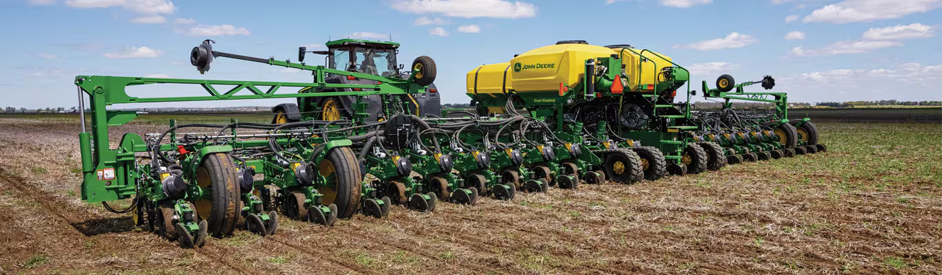
Why is Seed Planting Equipment Important?
Ensures uniform seed placement and spacing
Maximizes germination rates and crop yields
Reduces labor and planting time
Notes:
"Let's start by discussing why seed planting equipment is important. Using the right equipment ensures uniform seed placement and spacing, which is crucial for proper germination. If seeds are planted too shallow, they might dry out, and if too deep, they may struggle to emerge. Proper spacing prevents plants from competing for nutrients while maximizing land use.
Another key benefit is that mechanized planting increases efficiency, reducing labor and planting time. Instead of planting by hand, modern planters can cover acres in just hours. This efficiency translates to higher germination rates and better yields, since seeds are placed at the right depth with good soil contact.
Looking at the image, you can see a modern planter pulled by a tractor. These machines use advanced technology, like GPS and sensors, to plant with extreme accuracy. By using the best planting method for their crop and soil type, farmers increase productivity and sustainability.
Now, let’s dive into different types of planting equipment, how they work and when to use them!

Slide 3
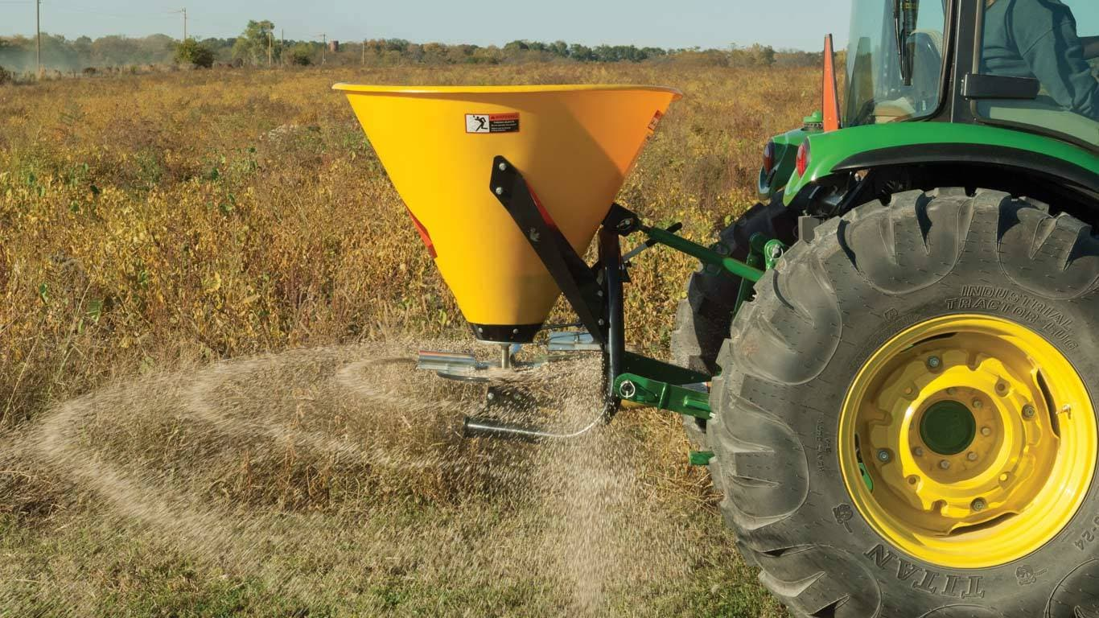
Broadcast Seeders
Scatters seeds randomly over the soil surface
Best used for: cover crops, grass, pastures
Advantages: Covers large areas quickly, low maintenance
Disadvantages: Uneven seed distribution, may require additional soil coverage
Notes:
Broadcast seeders are one of the simplest and fasted ways to plant seeds over a large area. This type of seeder is commonly mounted to a tractor and works by scattering seeds randomly over the soil surface.
Broadcast seeders are best used for cover crops, grass, and pastures, where precise seed placement isn’t as important.
One of the biggest advantages of a broadcast seeder is that it covers large areas quickly with minimal effort. It’s also low maintenance, requiring little adjustment compared to more complex planting equipment.
However, a key disadvantage is that seed distribution can be uneven. Since seeds are scattered randomly, some areas may receive too many seeds while others don’t get enough. To improve germination, farmers often follow up by lightly incorporating the seed into the soil with a harrow or roller.
So, while broadcast seeding is efficient and widely used, it’s not the best choice for crops that require uniform spacing and depth, like corn or soybeans

Slide 4
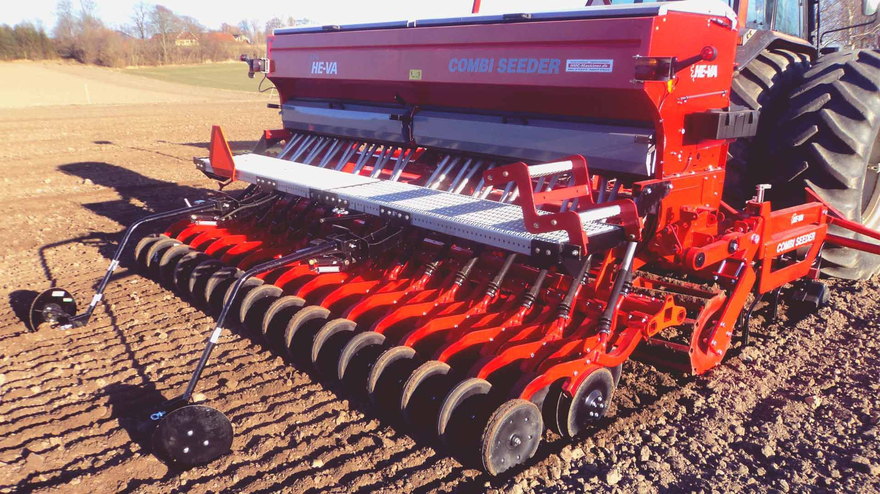
Grain Drills
Plants seeds in evenly spaced rows
Best used for small grains like wheat, barley and oats
Advantages: improves seed to soil contact, uniform emergence
Disadvantages: Requires more time compared to broadcast seeding, higher initial cost
BD7600 | Great Plains Grain Drills
Notes:
Next, let’s talk about grain drills, which are designed to plant seeds in evenly spaced rows at a controlled depth. This type of seeder is commonly used for small grains like wheat, barley, and oats.
Unlike broadcast seeders, which scatter seeds randomly, grain drills place seeds in precise rows, improving seed-to-soil contact. This leads to better germination rates and more uniform plant emergence, giving crops a strong, even start.
One of the key advantages of a grain drill is that it reduces seed waste and ensures more consistent plant stands, which improves overall yield potential. Additionally, because seeds are placed at a controlled depth and covered with soil, they are less exposed to wind, birds, or other factors that might affect germination.
However, grain drills require more time compared to broadcast seeding since they work row by row rather than spreading seeds across a wide area. They also come with a higher initial cost, making them a more significant investment for farmers.

Slide 5
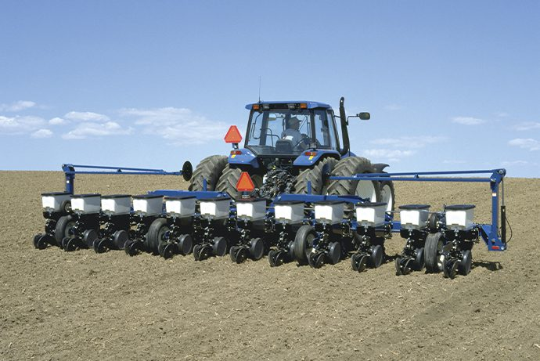
Row Crop Planters
Places seeds in precise rows at uniform intervals and depth
Best used for corn, soybeans, cotton
Advantages: Optimized plant spacing, improved yield potential
Disadvantages: Expensive, requires more tractor power
Virtual Tour | John Deere MaxEmerge™ 5
Notes:
Now, let’s discuss row crop planters, which are one of the most precise planting tools used in modern agriculture. These planters are designed to place seeds in precise rows at uniform intervals and depth, which is crucial for crops that require consistent spacing to maximize growth and yield.
Row crop planters are best used for corn, soybeans, and cotton, where proper seed placement directly impacts plant health and efficiency. These crops need even spacing to avoid overcrowding, ensuring that each plant gets enough sunlight, water, and nutrients to grow optimally.
One of the main advantages of row crop planters is their ability to optimize plant spacing and improve yield potential. By placing seeds at the correct depth and distance apart, they promote uniform emergence and minimize competition between plants. This also allows for more efficient fertilizer application and easier mechanical harvesting, further improving productivity.
However, these planters also come with disadvantages. They are expensive and require a significant upfront investment. Additionally, they need more tractor power compared to simpler planting methods, which means higher fuel costs and more maintenance.
Despite these challenges, row crop planters are essential for large-scale grain and fiber crop production. Their precision and efficiency help farmers maximize their land’s potential while reducing waste and labor.

Slide 6
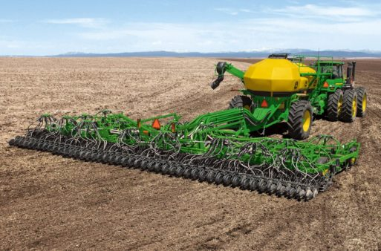
Air Seeders
Uses air pressure to distribute seeds through tubes
Best used for small grains and cover crops
Advantages: Uniform seed distribution, works in no-till systems
Disadvantages: Expensive, requires an air compressor
Case IH Precision Disk 500DS Air Drill
Notes:
Now let’s look at air seeders, which use air pressure to distribute seeds through tubes, rather than relying on gravity like traditional planters. This allows for even seed distribution across a wide area, making them particularly useful for large-scale planting.
Air seeders are best suited for small grains and cover crops, such as wheat, barley, and rye. These crops don’t require precise row spacing like corn or soybeans, so air seeders are an efficient choice for quickly covering a large field.
One of the key advantages of air seeders is that they provide uniform seed distribution, ensuring that seeds are spread evenly across the field. They also work well in no-till systems, where reducing soil disturbance is a priority for preventing erosion and improving soil health.
However, air seeders do have some disadvantages. They are expensive due to their advanced technology and large size. They also require an air compressor to create the pressure needed for seed distribution, adding to maintenance and operational costs.
Despite the cost, air seeders are an excellent choice for farmers planting large acreages of small grains or using conservation tillage methods

Slide 7
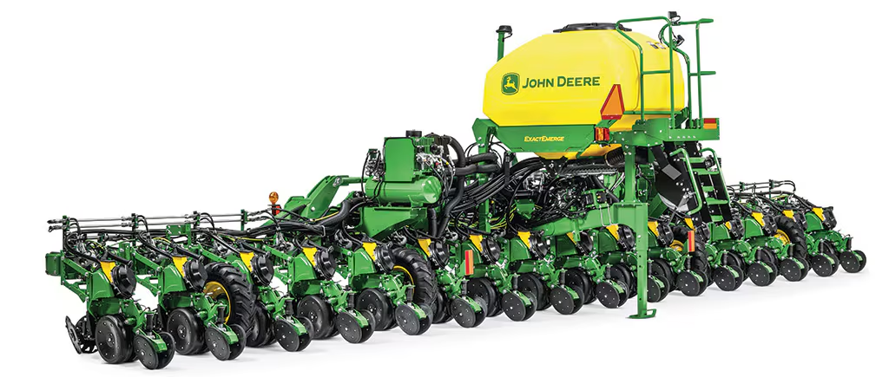
Factors to Consider when Choosing Equipment
Crop type and seed size
Field size and terrain
Tillage system
Budget and maintenance costs
Notes:
When selecting the right seed planting equipment, farmers must consider several key factors. Let’s go through each of these considerations:
Crop Type and Seed Size – Different crops require different planting methods. For example, small grains like wheat or barley are best suited for grain drills or air seeders, while row crops like corn and soybeans require row crop planters. Seed size also matters because some planters require adjustments for different seed types.
Field Size and Terrain – The size and topography of the field influence equipment choice. Large fields require high-capacity, efficient planters to cover more acres quickly, while smaller or irregularly shaped fields might be better suited for smaller, more maneuverable machines. Hilly or uneven terrain may also limit the use of certain planting equipment.
Tillage System – The farmer's tillage practices affect what equipment will work best. Conventional tillage systems typically use drills or row planters, whereas no-till or conservation systems require specialized equipment like no-till drills or air seeders to minimize soil disturbance and maintain soil structure.
Budget and Maintenance Costs – The cost of purchasing and maintaining equipment is a major consideration. Precision planting equipment, for example, offers better accuracy and efficiency but comes with a higher upfront cost and may require more technical expertise. Farmers must balance initial investment, operating costs, and long-term benefits when making a decision.
Ultimately, choosing the right planter involves weighing these factors based on the farm’s goals, land characteristics, and financial resources. Making the right choice can maximize yield, reduce costs, and improve overall farm sustainability

